Slide 1



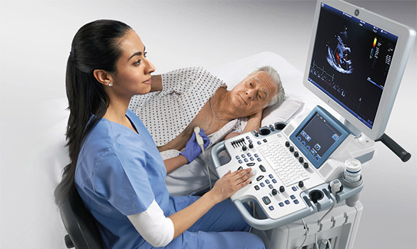
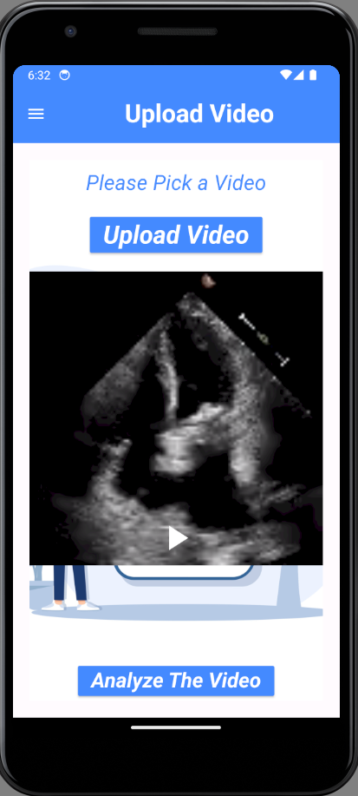
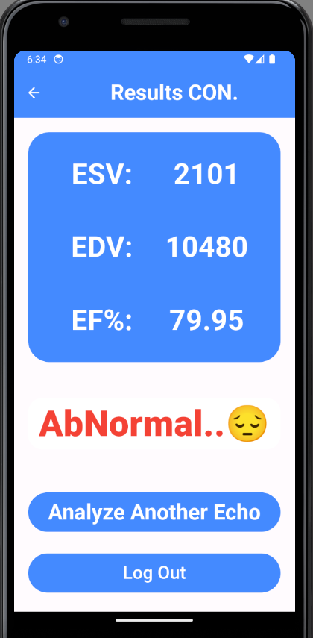
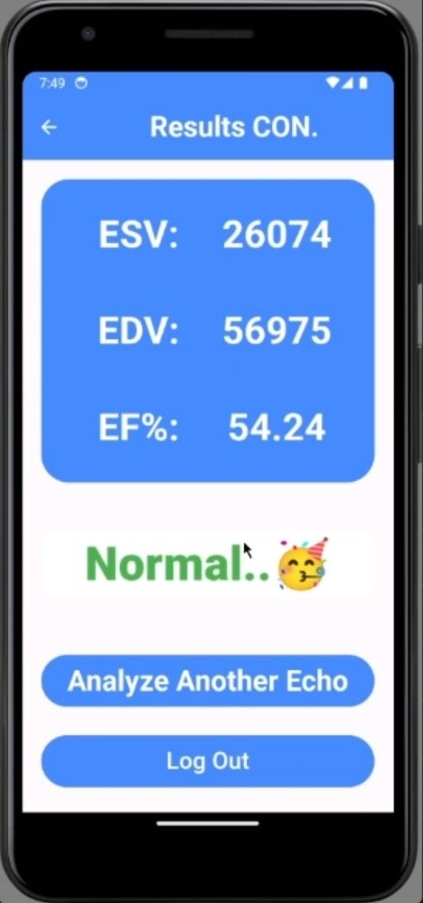
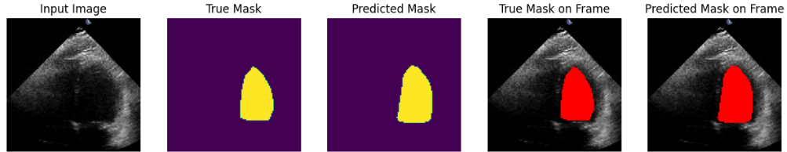
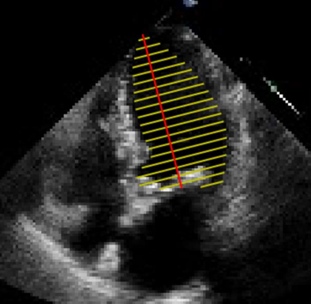
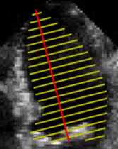
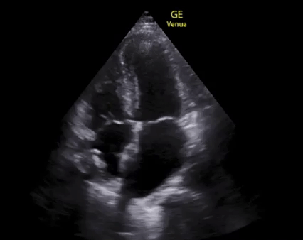
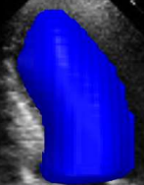
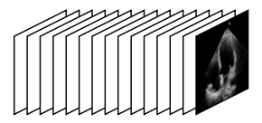
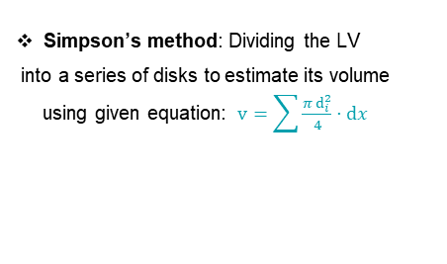
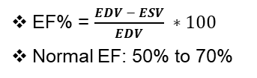
Echo-Based Cardiac Function Assessment
Abanoub Gamal, Kerolos Nabil, Kerolos Helal,
Kerlos Waheed, Yassa Kamille, Ganna Muhammed
Dr. Manal Mohsen Tantawi, TA. Radwa Reda
Scientific Computing Department
Faculty of Computer and Information Sciences - Ain Shams University
Introduction
Results
The critical issue of accurate cardiac function assessment using echocardiography highlights its importance in diagnosing and managing heart diseases. The project aims to improve diagnostic accuracy through advanced image processing techniques and machine learning algorithms. We aim to develop a robust system that aids patients and clinicians by providing precise and reliable cardiac function evaluations.
The Echo-Based Cardiac Function Assessment app aims to revolutionize cardiac care by providing a powerful tool that combines advanced technology with ease of use. This app not only enhances the capabilities of healthcare providers but also empowers patients with crucial insights into their heart health.
Problem Definition
The heart, particularly the left ventricle, is crucial for blood circulation.
Conditions like cardiomyopathy impair heart function, leading to serious health issues.
Echocardiography, a non-invasive imaging technique, is essential for diagnosing heart conditions by measuring parameters like the Left Ventricle.
Ejection Fraction (LVEF).
Newly trained cardiologists often struggle with accurate and rapid diagnoses due to the complexity of echocardiographic data.
Motivation
Cardiovascular diseases are a leading cause of death globally, affecting over 500 million people and causing around 20.5 million deaths in 2021.
Early detection and continuous heart health monitoring can significantly reduce risks and improve outcomes.
Heart assessment apps can provide personalized care, enhance accessibility, and empower patients.
Objective
Develop a system to accurately assess cardiac function and estimate LVEF from echocardiograms, aiding in early diagnosis and management of heart conditions.
Proposed Solutions
Utilize advanced diagnostic tools like AI and machine learning for analyzing echocardiographic data.
Implement telemedicine for remote consultations.
Emphasize continuous education and training for new cardiologists Adopt a multidisciplinary approach for comprehensive patient care.
The project aims to leverage technology to enhance diagnostic accuracy, speed, and overall cardiac care.
Building a Mobile App that can hold the workflow, particularly facilitating the process for juniors or weakly experienced doctors and get the EF with classification normal or not.
Along with optimizing and enhancing experience for users at all skill levels.
Conclusions
This project addresses a critical issue facing heart failure people the objective was to develop software that gets the ejection fraction of a heartbeat from the echocardiography video and that was achieved using Deep learning models (DL).
Throughout the development process, we have utilized a variety of programming languages, development tools, and third-party services to ensure that our app is user-friendly and reliable. We have also developed comprehensive technical and user documentation to support the development and deployment process.
Our goal is to create a system that meets the needs of doctors everywhere and helps them to provide an accurate diagnosis of heart failure to the Patients.
We believe that our app has the potential to make a positive impact on the diagnosis process and we are excited to see it in action and help more people to see their evolution and save their lives.
Methods
Hyper Model
The module uses ResNetAE and BERT-based transformer encoders to capture echo video sequences and detect ES&ED Frames.
U-Net Network
The U-Net is a supervised CNN for image segmentation to detect Left Ventricle (LV) Mask.
Fast API
Enabling requests to the model
Returning response from the model
Hosting model to the server and deploying it to mobile application.
Flutter Application
Send the echo video to the app and get the EF
Connecting with the mode
Bibliography
U-Net Model :
Ouyang, D., He, B., Ghorbani, A., Yuan, N., Ebinger, J., Langlotz, C.P., Heidenreich, P.A., Harrington, R.A., Liang, D.H., Ashley, E.A. and Zou, J.Y. Video-based AI for beat-to-beat assessment of cardiac function. Nature. 2020.
Reynaud, H., Vlontzos, A., Hou, B., Beqiri, A., Leeson, P. and Kainz, B. Ultrasound video transformers for cardiac ejection fraction estimation. In Medical Image Computing and Computer Assisted Intervention–MICCAI 2021: 24th International Conference. Springer International Publishing. Strasbourg, France. 2021. pp. 495-505.
Duffy, G., Jain, I., He, B. and Ouyang, D. Interpretable deep learning prediction of 3d assessment of cardiac function. In Pacific Symposium on BiocomputIng .2022. pp. 231-241.
Liu, X., Fan, Y., Li, S., Chen, M., Li, M., Hau, W.K., Zhang, H., Xu, L. and Lee, A.P.W.Deep learning-based automated left ventricular ejection fraction assessment using 2-D echocardiography. American Journal of Physiology-Heart and Circulatory Physiology. 2021. 321(2), pp.H390-H399.
Simpson’s method: Dividing the LV
into a series of disks to estimate its volume
using given equation: $v=\sum{\frac{πⅆ_{i}^{2}}{4}}⋅ⅆx$
Video Analysis
Detect
(ES –ED) frames
Get the binary mask to left ventricle
Landmarks Detection
Calculate Volume
Calculate Ejection Fraction
Classification
Normal
frames
Transformer ResNet-BERT
EF% = $\frac{EDV − ESV}{EDV} ∗100$
Normal EF: 50% to 70%
Abnormal

